Slide 1
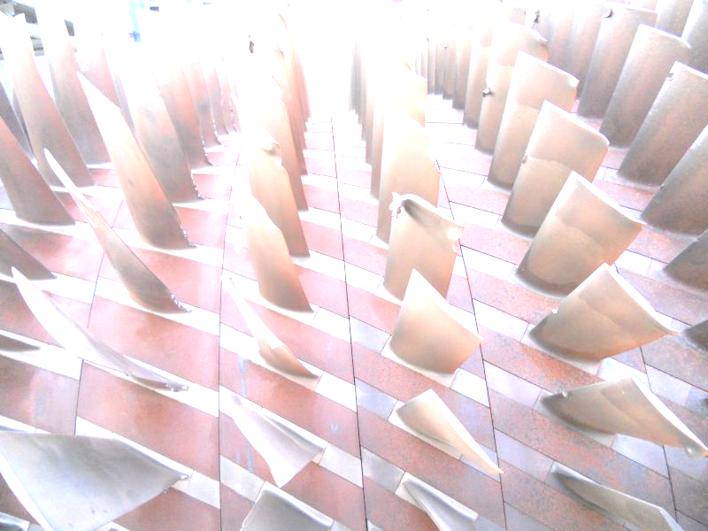
Insurance Claims Workshop 2017
Managing Complex and Contentious Claims
Property Claims:
Underwriting Perceptions vs Reality
Mahmood Ahmed | CEO – HMCL
Khurram Ali Khan | Sr. Executive Director – EFU
22 March 2017
MARSH - CERM Pakistan

Slide 2
What is Your Why

Slide 3
Outline
Property Losses – Do’s and Dont’s
Reasons of Contentious Claims
Conclusion
Claim examples
Case Study
Q & A

Slide 4
Property Losses – Cause examples
Adverse Weather
Breakdown
Collapse
Corrosion
Cracking
Defective Material
Earthquake
Explosion
Faulty Design
Faulty Workmanship
Fire Damage
Flood Damage
Landslide
Hurricane
Impact
Implosion
Lighting
Mold
Natural Hazards
Negligence
Overheating
Overload
Overspeed
Short circuit
Storm
Subsidence
Terrorism
Testing
Theft
The list goes on………..

Slide 5
Dos and Don’ts
Do’s:
Always Expect the claim to happen and plan accordingly
Involve the right people.
Agree the process and clearly define the focal points and reporting frequency.
Appreciate the vital importance of timely “incident notification”.
Agree that time and money will be invested in setting up the investigation process at Policy inception.
Recognize the value of effective determination of the actual cause of the damage – this should precede policy interpretation.
Agree that communication take precedence and should be pursued where possible. Action points are then minuted and agreed.
Avoid linear communication and ensure all parties are fully informed.
Obtain confirmation from all stakeholders at each stage of the process – set expectations.
Understand and accept that each stakeholder has obligations and clear responsibilities both to the team and his / her employer.
Agree response time parameters – and stick to them.

Slide 6
Dos and Don’ts (continued)
Don’t:
Cut corners at the outset – time invested here reaps rewards when / if a loss occurs.
Ever “assume” that
  ticking a box on a form is the same as communication
  what you say is what is heard – check that the message and the intent of the message is communicated
Exclude stakeholders

Slide 7
Reasons leading to Contentious claims
Some examples:
Incorrect selection of insurance cover.
Inadequate and/or selective sum insured
Lack of understanding on basis of settlement under ordinary fire policy, reinstatement, various engineering policies, broker manuscript policies etc.
Improper Risk Management.
Lack of understanding of policy conditions and endorsements e.g. MRe 110 for safety measures during construction, “Machinery Breakdown” concept vs “Machinery Insurance” coverage.
Technological advancement and obsolescence.
Normal wear and tear vs sudden and unforeseen damage.
Delay in Root Cause Analysis / Forensic Analysis.
Serial Losses.
Lack of cooperation from the Insured’s representatives.
Change in risk not notified
Incorrect location
Breach of warranties

Slide 8
Claim Examples

Slide 9
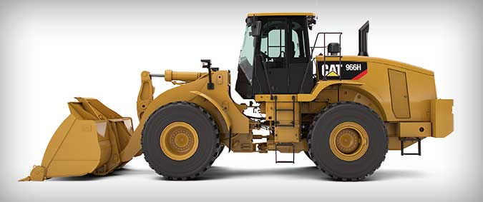
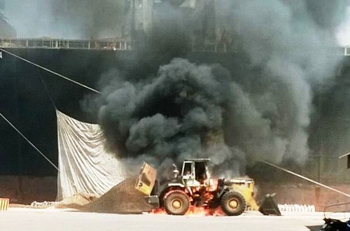
Damage to Wheel Loader – Basis of Settlement in Engineering Policies
Covered under CPM policy.
Basis of sum insured on New Replacement Value (NRV).
Insured Claimed Rs. 42 million for total loss
Settled by loss adjuster for Rs. 15 million
Reasons for drastic reduction:
Insured presumed that loss would be settled on declared values.
Whereas NRV is tool to calculate correct premium.
NRV has no relationship with the claim settlement.
Such machinery are subject to high wear & tear.
Obsolesce factor comes into account.
Wordings defined in a manner to cater partial losses which are frequent in numbers.
Whereas in total loss depreciation would apply because chances of total loss is quite rare.

Slide 10
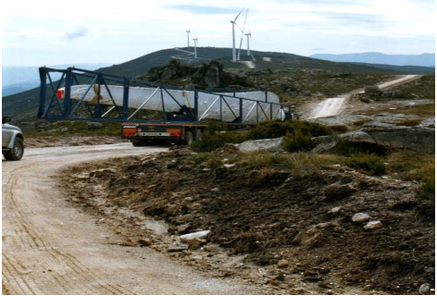
Risk Aggravation due to location of a wind farm Access Road
CAR cover
A wind farm project in a mountainous area of Southern Europe - 2011
Oversized loads due to the size of the blades.
Area not served by public roads. As a part of sum insured, temporary access roads built. Small villages and farm fields had to be adapted accordingly and some stone walls had to be demolished to allow transportation.
Immediately restored to original condition once turbine blades delivered on site.
During the testing phase a blade got irremediably damaged and had to be replaced with a new one. By then all the dry stone walls had already been rebuilt to restore original conditions so that it was necessary to demolish them again.
As a consequence the contractor had to restore all temporary access facilities for the replacement of a single blade actually doubling the initial budget for access roads interventions and counting for a relevant part in the overall cost of the blade failure (loss).

Slide 11
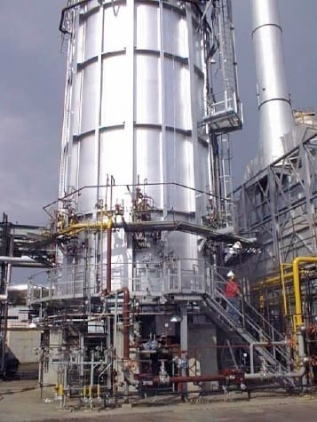
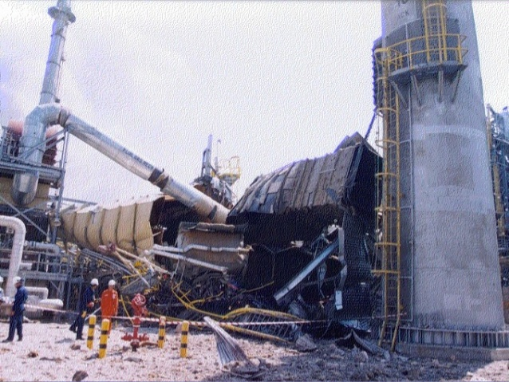
Explosion at Petrochemical Plant – Incorrect selection of insurance cover
Standard Fire Policy covering Plant, Machinery(s) was issued
Damage to furnace and claimed for Rs. 4 billion (PD & BI)
Loss was assessed for Rs. 560 million (excluding BI)
Observations :
Instead of Industrial All Risk Policy, standard fire policy was issued
BI was not taken up
Insured suffered both PD & BI losses
The risk had a mixture of new & old machinery
Breakup values of major items were not provided
Safety features were not implemented.

Slide 12
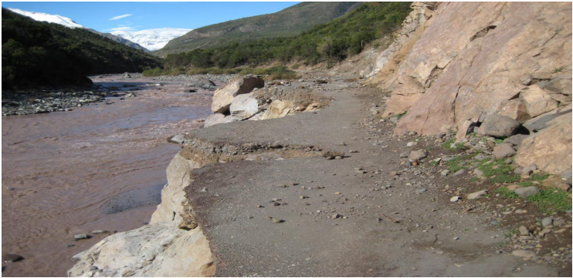
A Controversial Hydropower project claim - Material Damage and DSU – Chile, 2008 – Damage to Govt. owned property leading to Project Delay
CAR with DSU Cover.
Some existing roads and some temporary roads were to provide access to the project – existing roads not part of sum insured.
Heavy rainfall in May 2008 resulted in an existing road being washed away.
9 months required by public authority to repair. DSU time excess 90 days.
5 months DSU Claimed due to an uninsured road damage.
Insurers considered that this damage occurred to property that was not insured and therefore not covered under the policy – possible litigation.
What was the outcome of the claims process???
Compromised settlement – main contractor carried out repair to save DSU.

Slide 13
A Controversial Hydropower project claim - Material Damage and DSU – Chile, 2008 (Continued)
Key lessons learnt:
Consider the location of the project and the exact scope of works when reviewing during the preparation of the underwriting case;
Be clear on the property insured/boundaries of the project site and whether it is part of the declared Sum insured. Is it clearly defined in the policy wording?
For policies with Delay in Start Up cover, further review the potential consequences of denial of access and the value of the DSU requested;
Discuss up front during negotiations with the insured their mitigation plans in the case of such an event.

Slide 14
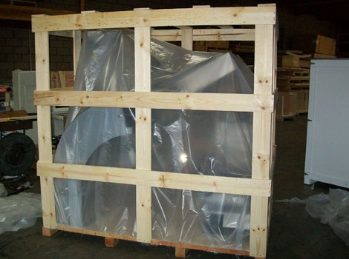
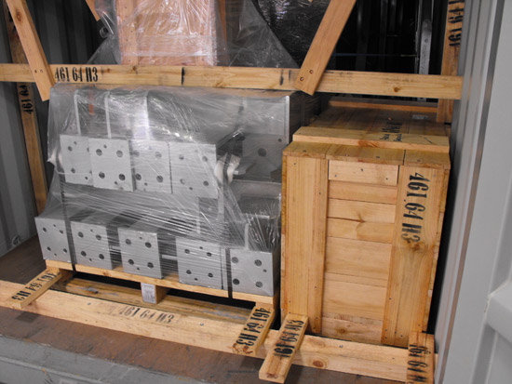
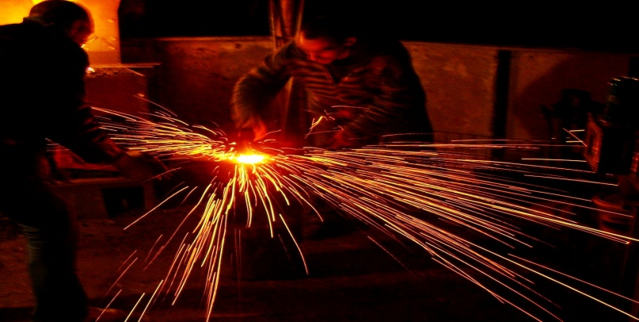
Erection of Cement Plant – Change in risk not notified
Principal controlled Insurance
Because of some dispute contract was terminated in between
Consignments kept on coming and were unloaded and stored at site
Site became idle.
Hence, there were no construction / erection activities at all
Silent risk coverage was provided and it continued in the manner for number of years
Perils covered were natural perils, theft & burglary subject to proper security arrangements
During minor shifting some welding work was done without permit, resulting in fire which engulfed the surrounding area
As coverage warranted no activity, therefore claim rejected by underwriter’s
Keep Insurers in the loop in respect of any minor change required under project insurance

Slide 15
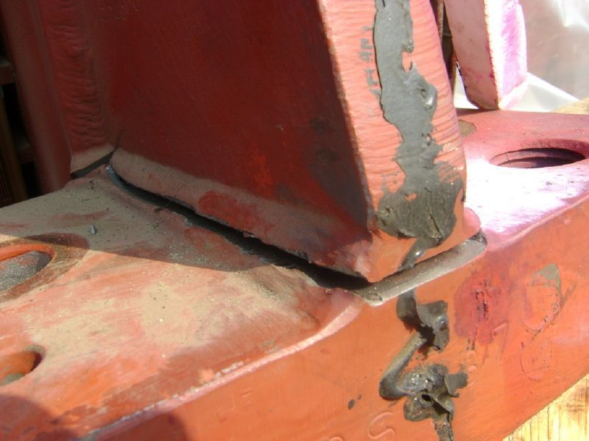
Improper Design Change
220 MW IPP HFO Diesel Generator PP– Alternator Damages – EAR/ DSU
To save project completion time, it was decided to purchase Converteam alternators instead of original design with ABB alternators . Proper design calculations were not done .
Resulted in cracks in base foot of alternators and alternator winding damage
A very interesting Vibration analysis by an internationally renowned lab was carried out –Extra weights were installed to control vibration
3 similar projects having 33 DG sets under erection in Pakistan had to review contracts and redesign.
Design fault was not covered in project insurance – Supplier compensated
Crack developed in welding of stator foot

Slide 16
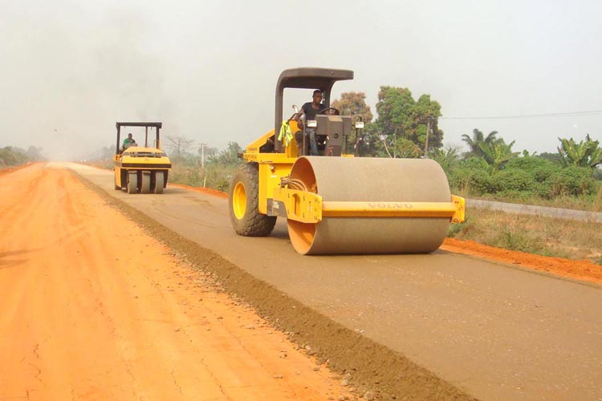
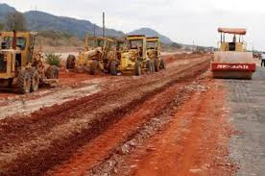
Damage to road works - Sectional Limit issues
Contractor’s All Risks policy
Construction of 50 KM road
Flood loss was claimed
Claimed for Rs 60 million
Assessed for Rs 22 million
Insured's opened number of sections at one time. However, the coverage for 4 sections were allowed (500 meter per section)
Insured at their convenience worked on 20 KM but limit of liability was up to 2-km (4 sections – 2,000 meter)
After deduction of compulsory deduction loss reduces drastically.
Insured need to understand the policy wordings !
And perform the job accordingly in line to the coverage

Slide 17
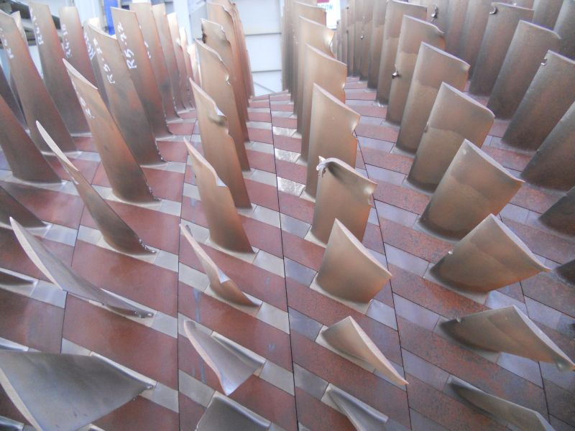
Serial Losses in Gas Turbines (Combined Cycle Power Plants)
220 MW Combined Cycle Gas Turbine IPPs – Compressor Damage
8 x 6FA GE Turbines are installed in 4 CCGT power plants in Pakistan
6 of these have suffered damages to their compressors since 2012 whilst in operational phase, almost similar causation.
Property Damage range – PKR 50 M to PKR 1 Billion.
Business Interruption - PKR 70 M to PKR 200 M
Interruption periods - 1 to 4 months
An underwriting nightmare!
Each RCA took several months. – stress corrosion cracking of 1 blade leading to subsequent damages or were these design faults or were a result of behaviour of the Grid in Pakistan???
No more incidents reported since the last 2 to 3 years after GE’s improvement in the materials of Compressor blades.

Slide 18
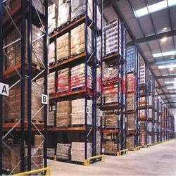
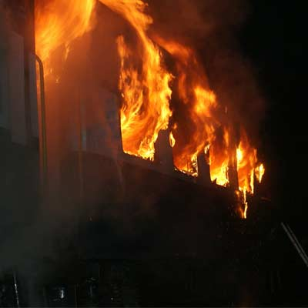
Capacity Constraint of Warehousing – Change in risk not notified
Fire and Allied Perils Policy was taken for a Storage Risk
At times, space problem arises.
Clients need to shift the goods between various godowns and at times to one big godown at same premises
Clients also use different godowns at their convenience which were located outside the premises
None of these movements / changes are advised to Insurer
Within few days of shifting fire incident occurs
Because of accumulation the exposure has increased manifold
Address of the storage location outside the premises was not declared
Warranties were applied
Limit of liability was defined
Loss was concluded at drastically lower values

Slide 19
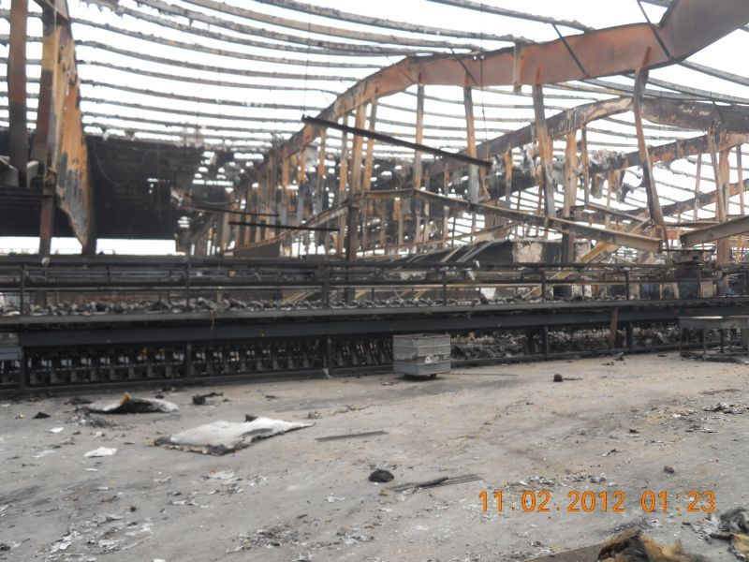
Spinning Mill completely gutted – Improper Risk Management
A spinning mill had pre-engineered panels construction with a false ceiling and fibre glass air-conditioning ducts. The whole process from blow room to auto cone was housed under one roof.
PML was 50% of the total sum insured.
Fire occurred in Blow Room, travelled through the false ceiling, fluff present above the false ceiling caught fire and engulfed the whole facility. The fibre glass ducts added as a catalyst.
Result – Total loss of the complete Spinning Mill
Claim PKR 1 billion
Settled around PKR 600 million
Lessons learnt:
Improper maintenance above the false ceiling.
Fire retardant material of insulation used in pre-engineered panel constructions is critical.
Proper Risk Inspections could have avoided this catastrophic loss.

Slide 20
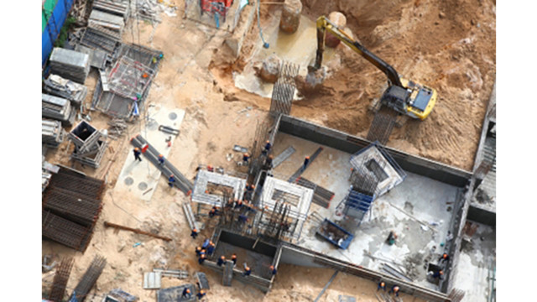
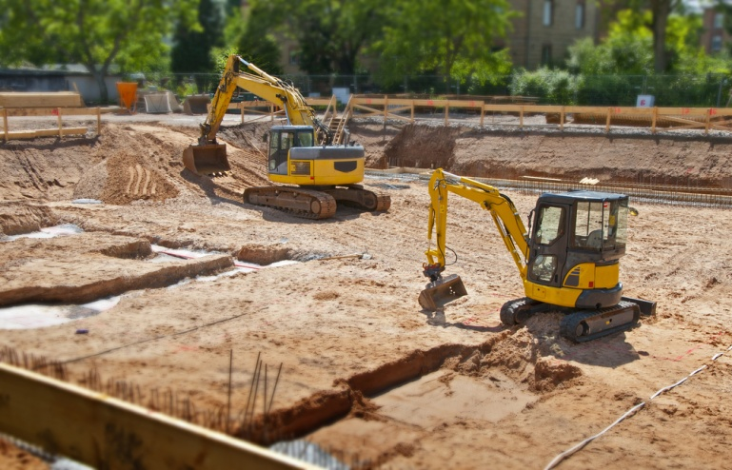
Damage to contract work – Contract price increase not notified
Claim under Contractor’s All Risks policy.
Insured claimed for Rs. 755 million.
Contract price increased due to additional work.
Material change in sum insured not notified to Insurer.
Contract work damaged due to flash flood but notified after 15 days.
Rehabilitation work started before the visit of loss adjuster.
Project was behind schedule.
Deviation allowed by 4 weeks.
On account of above breaches the loss was repudiated.

Slide 21
New Technologies in Pakistan – Underwriting perception vs Reality in the making
Some of the new technologies introduced in Pakistan in the recent past include Wind farms and Photovoltaic (Solar) plants.
Hence the perception of the risk vs actual experience in terms of claims and causations not generally available.
What can go wrong with a simple solar power plant module or a wind turbine installation? Here are some visuals to create awareness!

Slide 22

New Technologies in Pakistan – Underwriting perception vs Reality in the making (continued)

Slide 23
Case Study

Slide 24
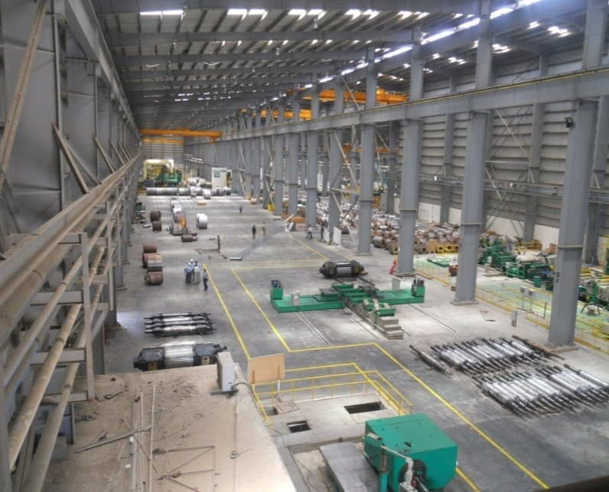
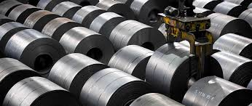
CASE STUDY
An Industrial Concern
A breakdown loss reported to the Insurers under All Risks Policy
(which included design defect but excluded faulty workmanship)
The insured Manufacturing Unit started suffering huge losses only after three months of commercial operation.
Instead of identifying the root cause of the damages for its rectification, the insured opted to run the mill and kept the production going.
After several months of continuous losses, Insured realized that the planned production cannot be achieved.
They took up the matter with the manufacturer of the plant for replacement of the machinery.
The manufacturer representative visited the mill and advised replacement of some parts, at the insured’s cost.
The Insurer were intimated of the losses after six months and the amount claimed was exorbitant which included total loss of the machinery, repair costs and business interruption.

Slide 25
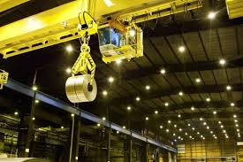
Case Study (Continued)
A loss adjuster was appointed. After initial survey and investigation, it transpired that the claim comprised of more than 100 individual failures/breakdowns spread over a period of more than six months.
Further, the rectification was carried out without providing an opportunity to the Insurer to inspect and record the physical evidence.
The Loss Adjuster indicated that the structural faults were there prior to the commencement of operational cover.
At the time of Loss Adjuster’s visit the cranes were operational and in working condition.
The Insured informed that all the cranes were malfunctioning from the beginning. It seemed highly unlikely that all the cranes of a reputable foreign firm, failed time and again.
EPC contractor was appointed who further awarded the work to different sub contractors. The construction work halted for more than one year and then another owner took over the plant and re-started the erection work .

Slide 26
Case Study (Continued)
Previous EPC contract was terminated and new management’s own technical team supervised the work and the plant was commissioned.
It was learnt that there were some manufacturing and installation problems in the structure which aggravated during and after installation of machines.
A Renowned consultant firm was hired to identify the cause of damages.
The consultant concluded following causes attributed to damages:
Under designed Pre Engineered Building (PEB) structure.
Poor manufacturing and installation of PEB.
Misalignment of crane Grids/Rails.
Below standard gear components manufactured.
Non compliance of the structure of the OEM during installation and operation.
    In view of the above facts, kindly advise if the loss is indemnifiable or not?.

Slide 27
Conclusion
In addition to improper underwriting, research has shown (IMIA WGP 92(15)) that most common factors leading to contentious claims are:
Lack of communication.
Lack of transparency.
Costly inefficiencies.
Distrust between stake holders.

Slide 28
Conclusion (continued)
Managing Complex and avoiding Contentious claims requires the following protocol :
Always expect a loss to occur and plan accordingly.
Create and agree a process that involves the key stakeholders throughout the claims process.
Establish a team to oversee that process.
Ensure that team members have adequate authority and competence.
Communicate effectively and frequently.
Conduct meaningful status reviews.
Agree a process for handling objections / challenges and disagreements.
As far as is practicable, encourage transparency.
Recognise that key details of the process may differ when applied to projects or to operational risks.
Maintain progress, if necessary through partial claim payments.

Slide 29
Thank you

